Slide 1
Front End
Lesson 1-2

Slide 2
Agenda
Web architecture
Components
HTML
Basic CSS
Assignments
Copyright © VTI Academy All Rights Reserved

Slide 3
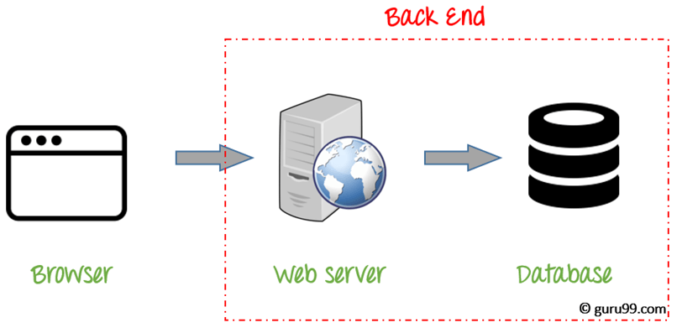
Web architecture

Slide 4

Components

Slide 5
Setup Software
Atom IDE
Visual studio code IDE

Slide 6
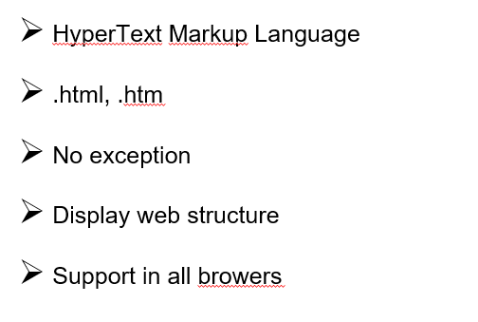
HTML Overview

Slide 7
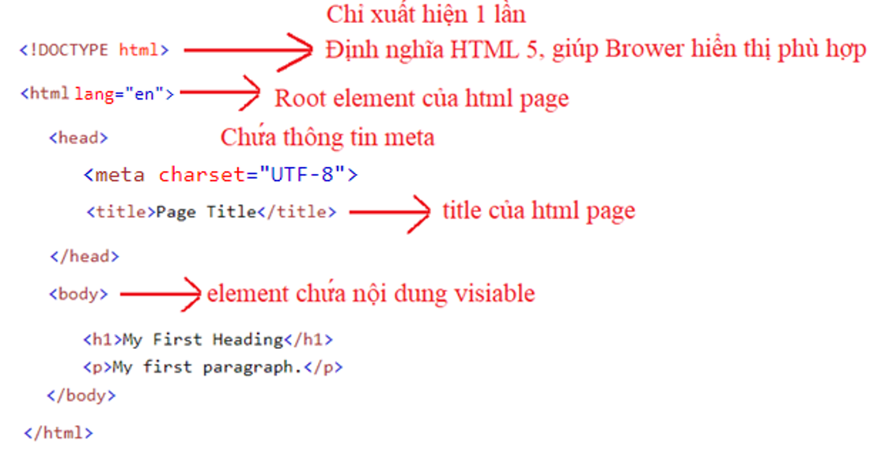
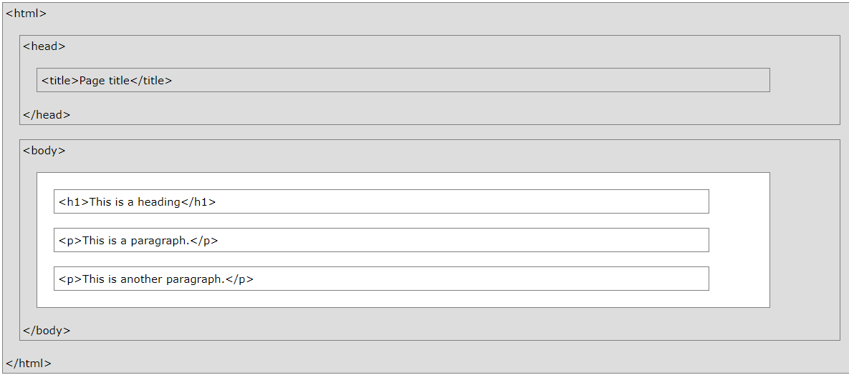
HTML Architecture

Slide 8
Head HTML
title
charset

Slide 9
Body HTML
heading tag
paragraph tag
formatting tag
form – input tag
Useful attribute
Grouping tag

Slide 10
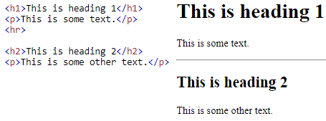
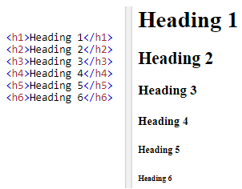
Heading tag
<h1>, <h2>, <h3>, <h4>, <h5>, <h6>
Logo or icon
Authorship information

Slide 11
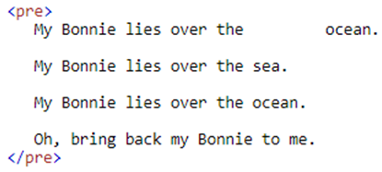
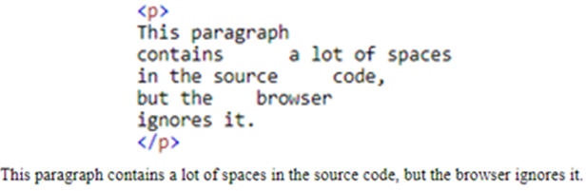
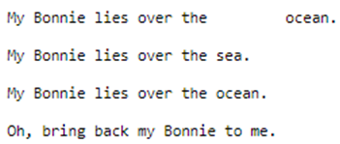
Paragraph tag
<p>: Paragraph, remove while space
<pre>: Paragraph, keeping whilte space

Slide 12
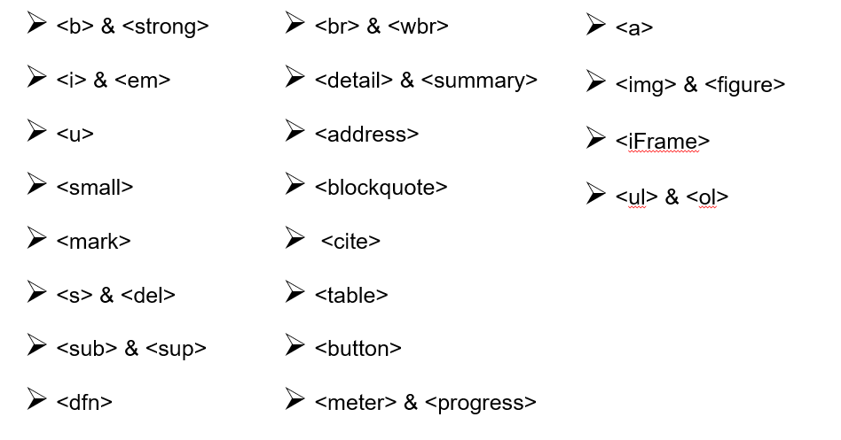
Formatting tag

Slide 13
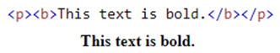
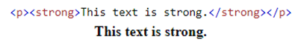
<b> & <strong>
<b>: (bold) without any extra importance
<strong>: with added semantic importance

Slide 14
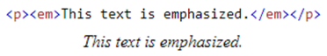
<i> & <em>
<i>: Italic, without any extra importance
<em>: emphasized, with added semantic importance

Slide 15
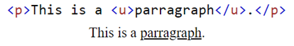
<u>

Slide 16
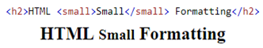
<small>
Smaller text

Slide 17
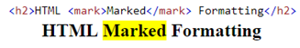
<mark>
Highlight text

Slide 18
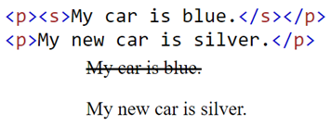
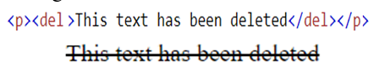
<s> & <del>
<s>
<del>: deleted

Slide 19
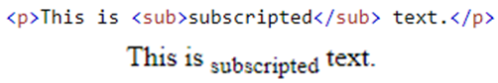
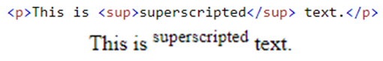
<sub> & <sup>
<sub>: subscripted
<sup>: superscripted

Slide 20
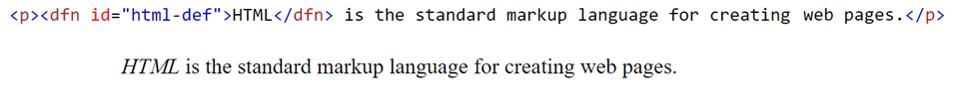
<dfn>
Define 1 keyword

Slide 21
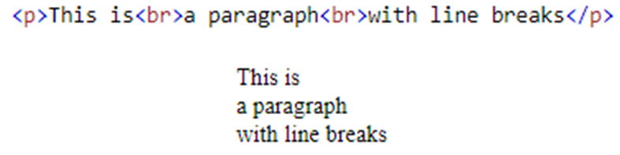
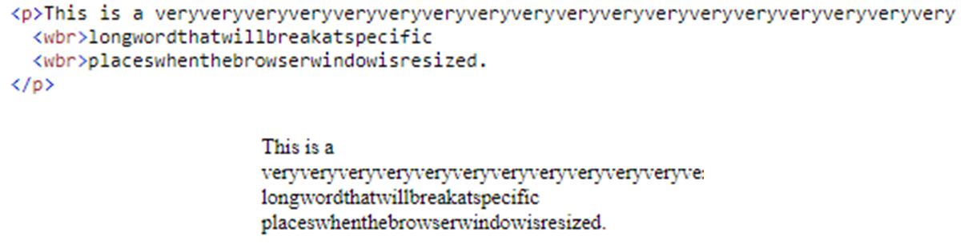
<br> & <wbr>
<br>: break line
<wbr>: Word Break Opportunity
1 từ quá dài → brower sẽ xuống dòng không đúng → dùng wbr để tách các từ đó ra

Slide 22
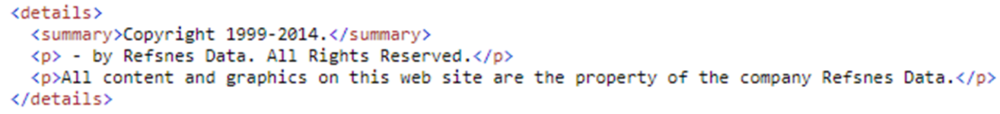

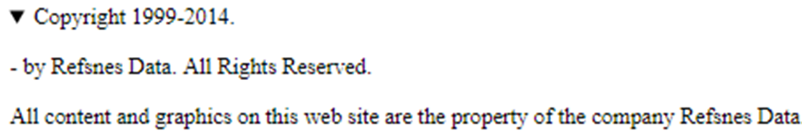
<detail> & <summary>
https://www.w3schools.com/tags/tryit.asp?filename=tryhtml5_details

Slide 23
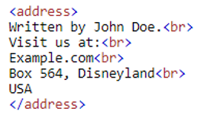
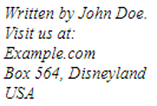
<address>

Slide 24
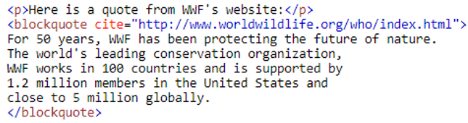
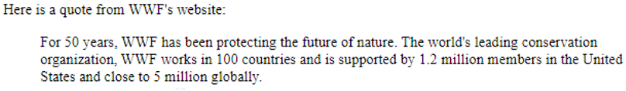
<blockquote>

Slide 25
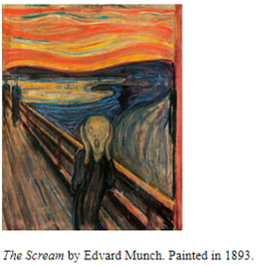
<cite>

Slide 26
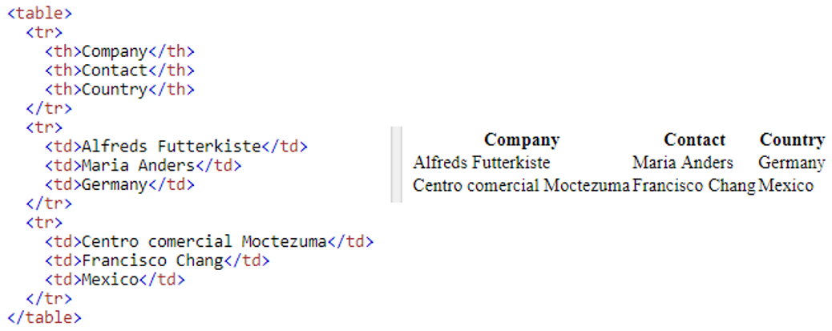
<table>
<th>: define header of table (default: bold and center)
<tr>: define row
<td>: define data (it can contain text, images, lists, other table,..)

Slide 27
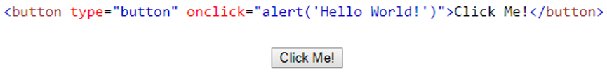
<button>

Slide 28
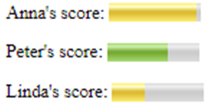
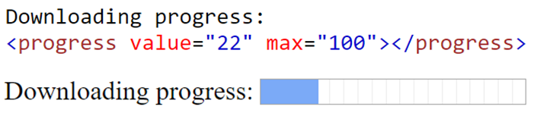
<meter> & <progress>

Slide 29
<a>
<a>: link

Slide 30
Other tag
<img> & <picture>
<iFrame>

Slide 31


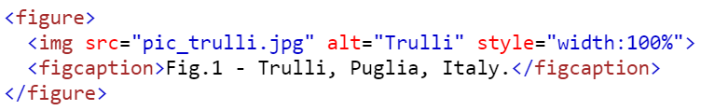
<img>
<img>: image
<figure> & <figcaption>: caption of image

Slide 32
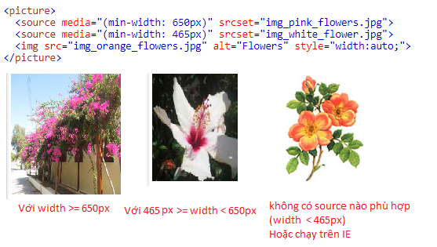
<picture>
flexiable than picture

Slide 33
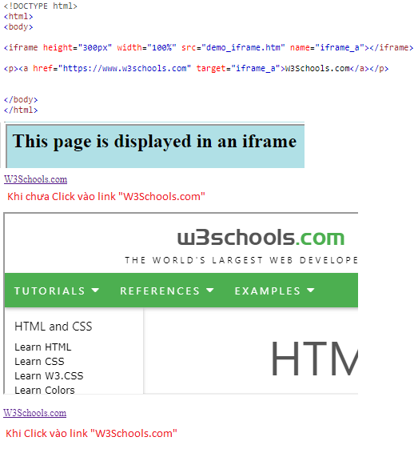
<iFrame>
https://www.w3schools.com/html/tryit.asp?filename=tryhtml_iframe_height_width_css

Slide 34
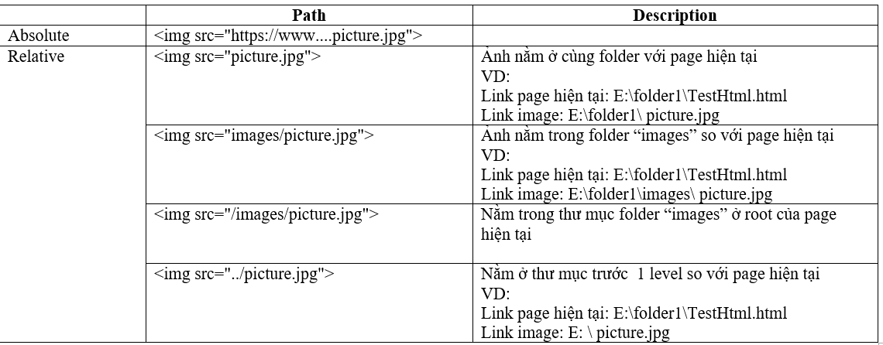
File path
Absolute
Relative

Slide 35
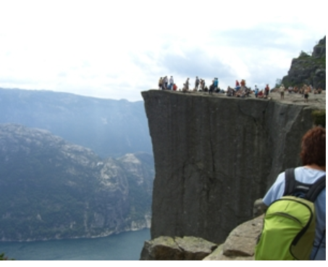
Absolute

Slide 36
Relative

Slide 37
<ul> & <ol>
<ol>: ordered list
<ul>: unordered list

Slide 38
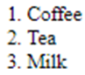
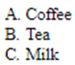
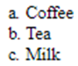
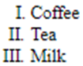
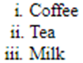
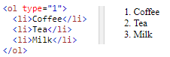
<ol>
1
A
a
I
i

Slide 39
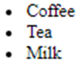

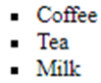
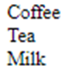
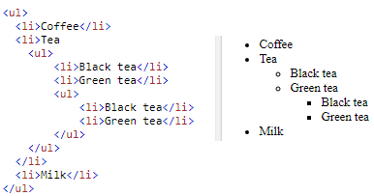
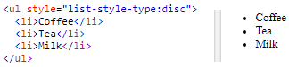
<ul>
disc
circle
square
none

Slide 40

<dl>
<dt>: term name
<dd>: content

Slide 41

Form - Input tag

Slide 42

Label
Define label for input tag

Slide 43


Text
text
textarea

Slide 44

Number

Slide 45

Range

Slide 46

Email

Slide 47

Password

Slide 48

File

Slide 49



Date & time
date
time
datetime

Slide 50


Date & time
month
week

Slide 51

Radio button
allow only 1 choosed option

Slide 52

Checkbox
allow 0 or multiple option

Slide 53

Select

Slide 54


Datalist

Slide 55

Group data

Slide 56

Submit form

Slide 57

Reset form

Slide 58

Useful Attribute

Slide 59

placeholder

Slide 60
disabled

Slide 61
readonly

Slide 62

max, min

Slide 63

required

Slide 64

size

Slide 65

autofocus

Slide 66

autocomplete

Slide 67
title

Slide 68
Grouping tag
div
span

Slide 69


Block and Inline
Block: always start in a new line, take full available width
Inline: continue in the current line, take necessary available width
Block
Inline

Slide 70


Block and Inline
Block tag
Inline tag

Slide 71

Comment
1 line
Multiple line

